Slide 1

Development of the Radiation Detector based on the Sensor Matrix of the Camera of CubeSat MONITOR-1
Project participants:
Gorbach Igor Yurievich
Efimkin Alexander Nikolaevich
Semenova Irina Andreevna
Fomichev Timofey Alexandrovich
Principal investigator:
Zolotarev Ivan Anatolievich

Slide 2




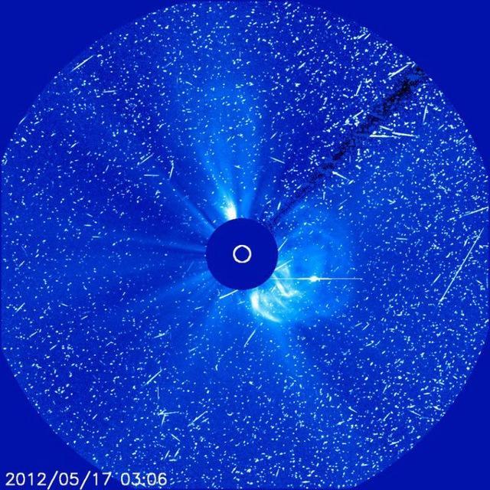
Goals and objectives
Goal:
– Development of the prototype of the radiation detector based on the matrix of the camera
Objectives:
– Develop algorithm to detect tracks
– Test algorithm on Earth
– Send the program to the satellite
– Receive and analyze photos from the satellite
– Develop the prototype of MADIZ
SOHO LASCO C3

Slide 3
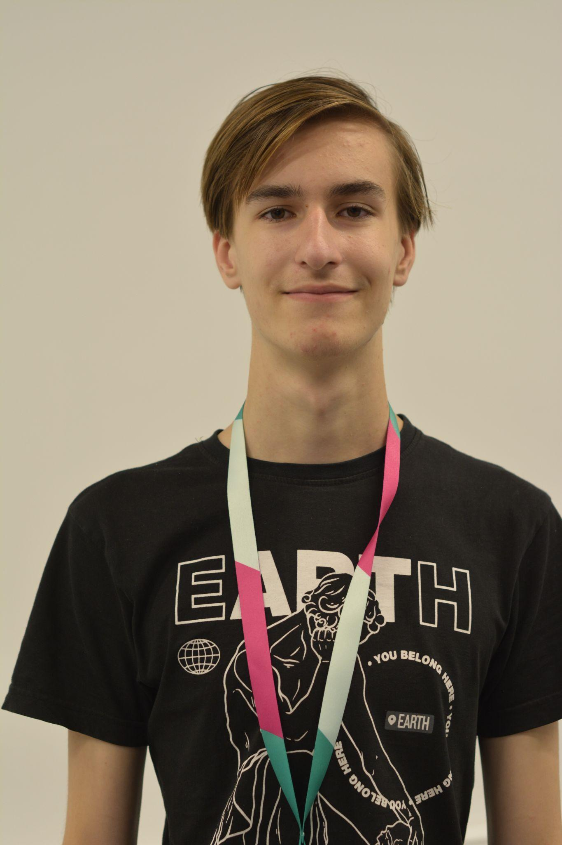
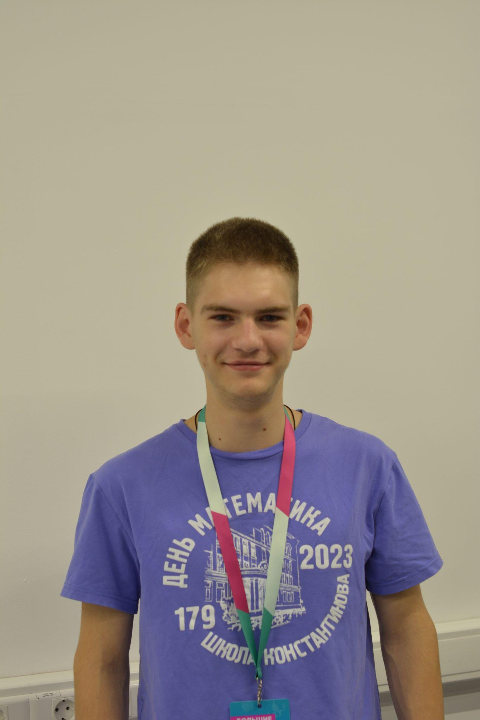
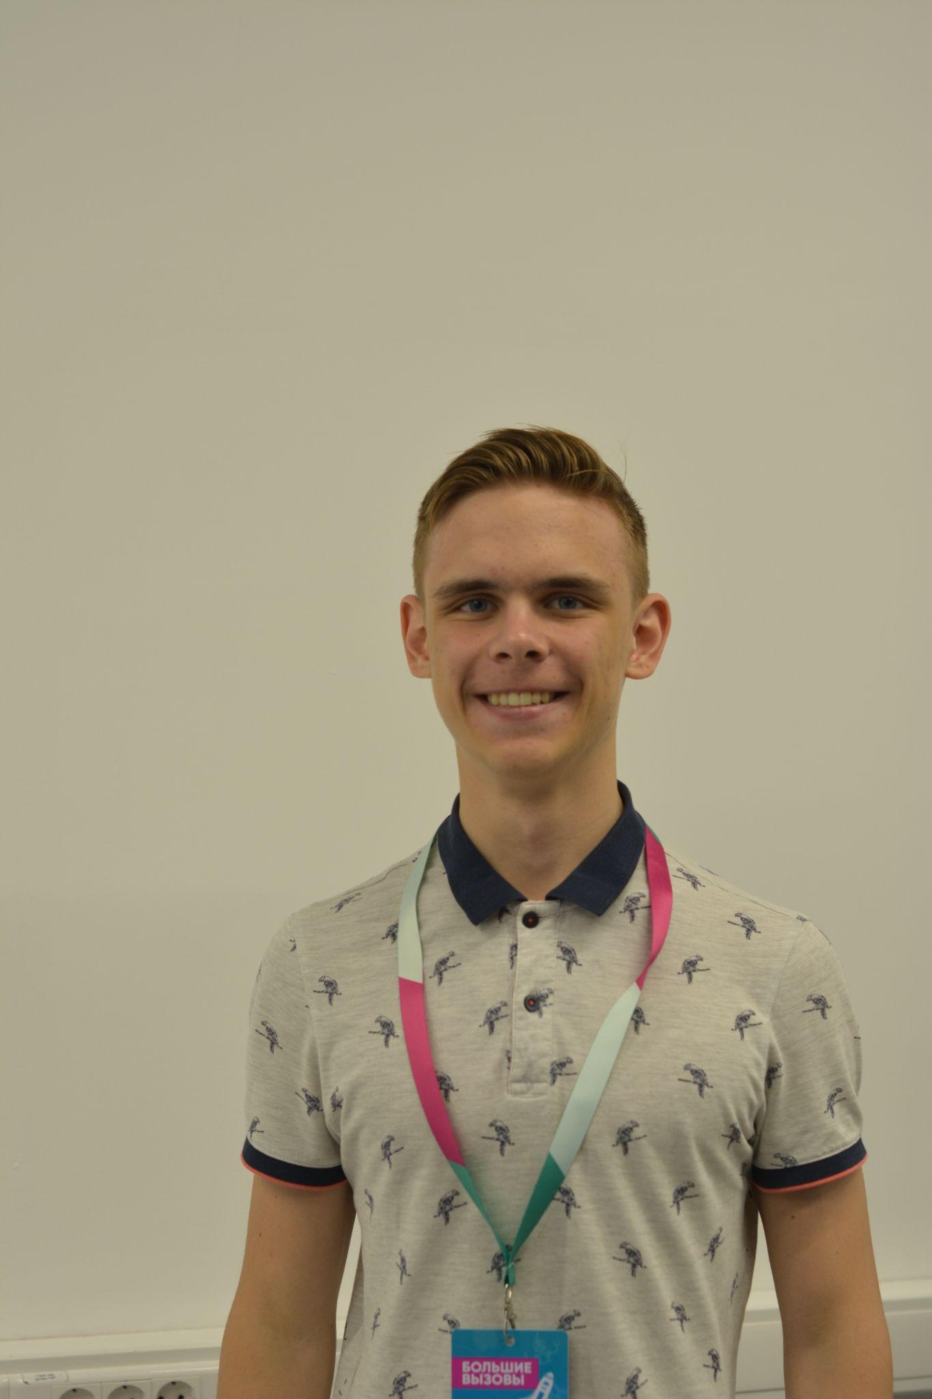
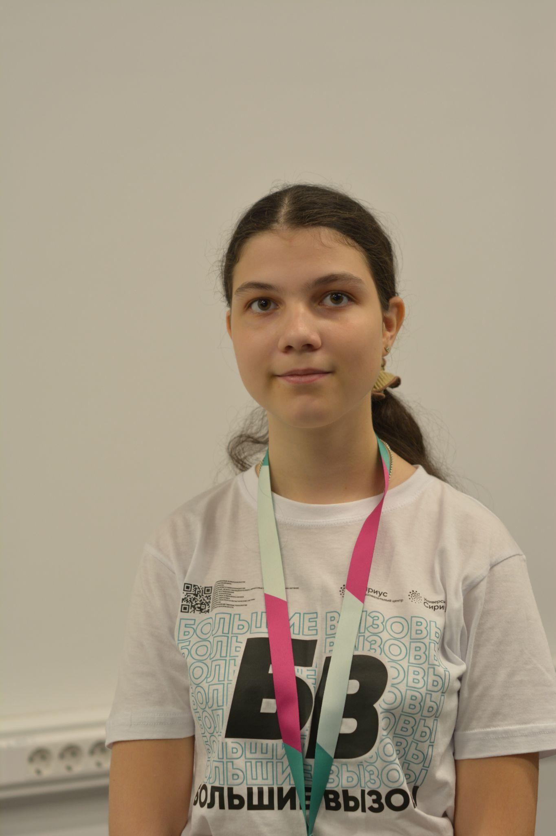
Team
Igor Gorbach
Alexander Efimkin
Timofey Fomichev
Irina Semenova
physics
engineer
programmer
programmer
programmer
programmer

Slide 4
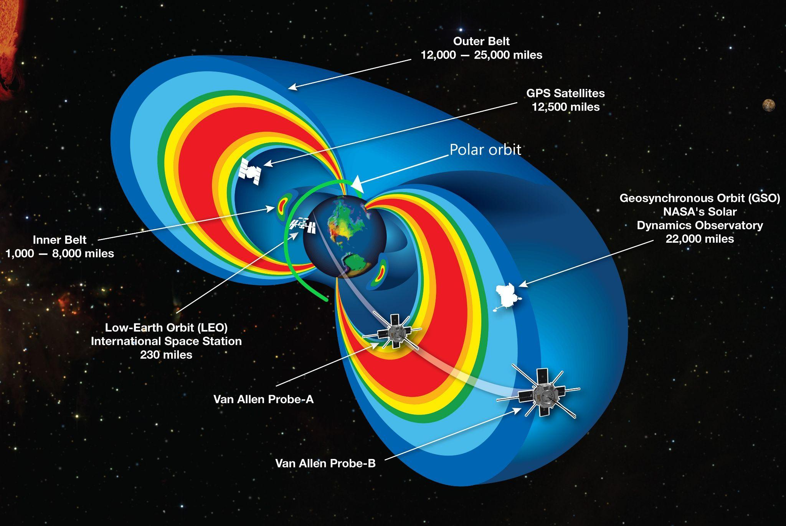
Relevance
Relevance:
– Exploration of the orbits with high level of radiation
– Ability to get a small radiation detector for every spacecraft
– Getting space weather data
– Getting 3D radiation map in real time
Notes:
Создание оперативной системы мониторинга радиационного фона

Slide 5
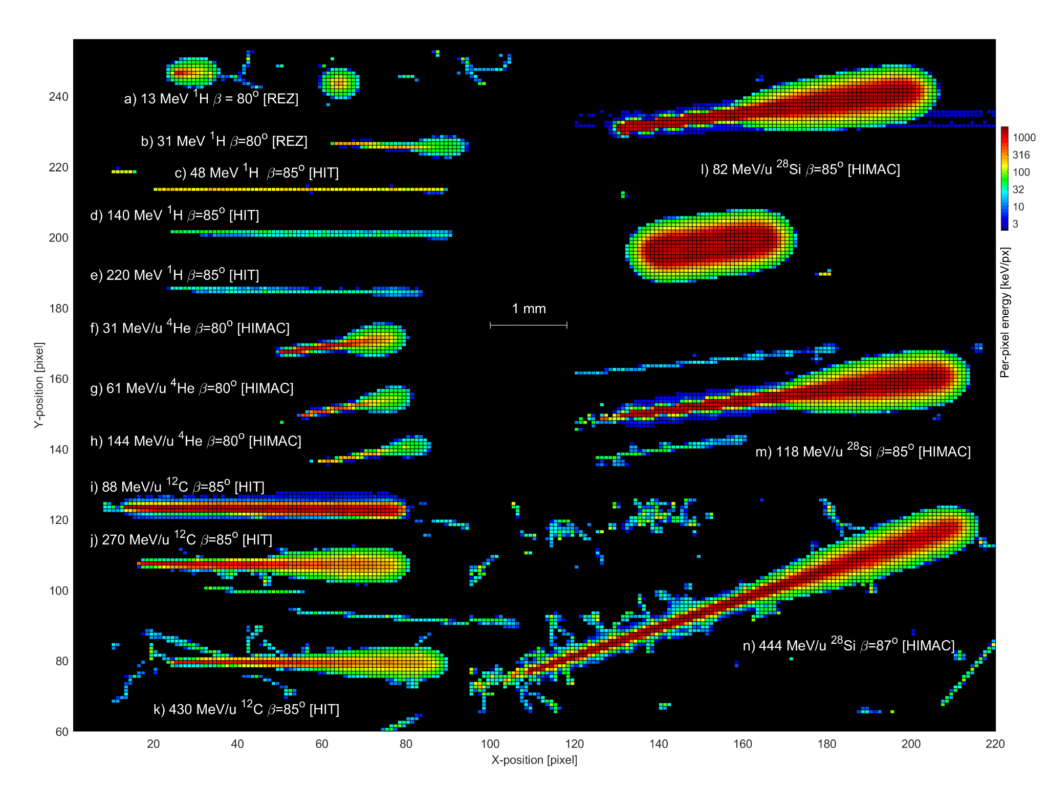
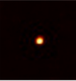
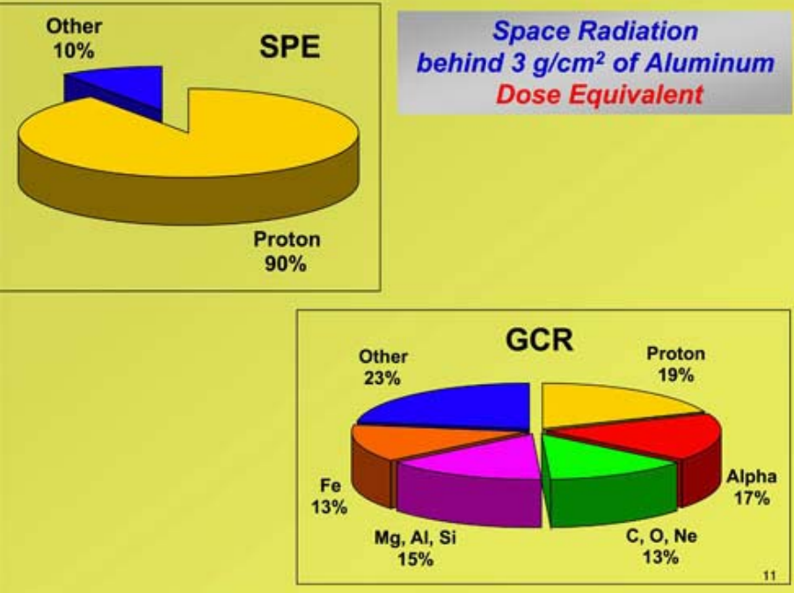
Physics
Relative contribution to the dose of various types of cosmic radiation
Example of a photon track.
Tracks of hydrogen atoms, (protons), different energies and electrons.
Track of the silicon atom and electrons.
The Space Radiation Environment: An Introduction Walter Schimmerling, Ph.D, Date posted: 02-05-2011
Notes:
добавить энергии. Пояснить с какими частицами работаем

Slide 6
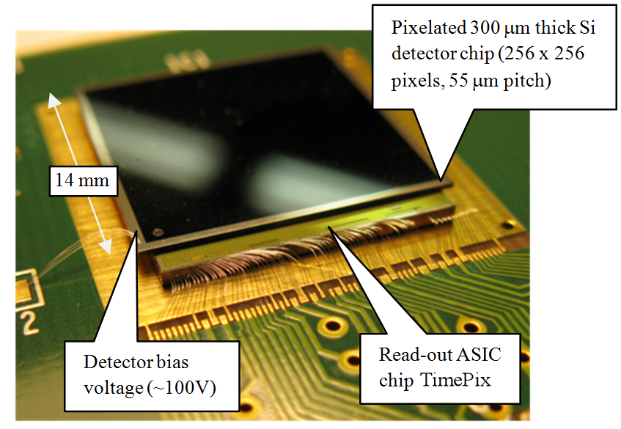
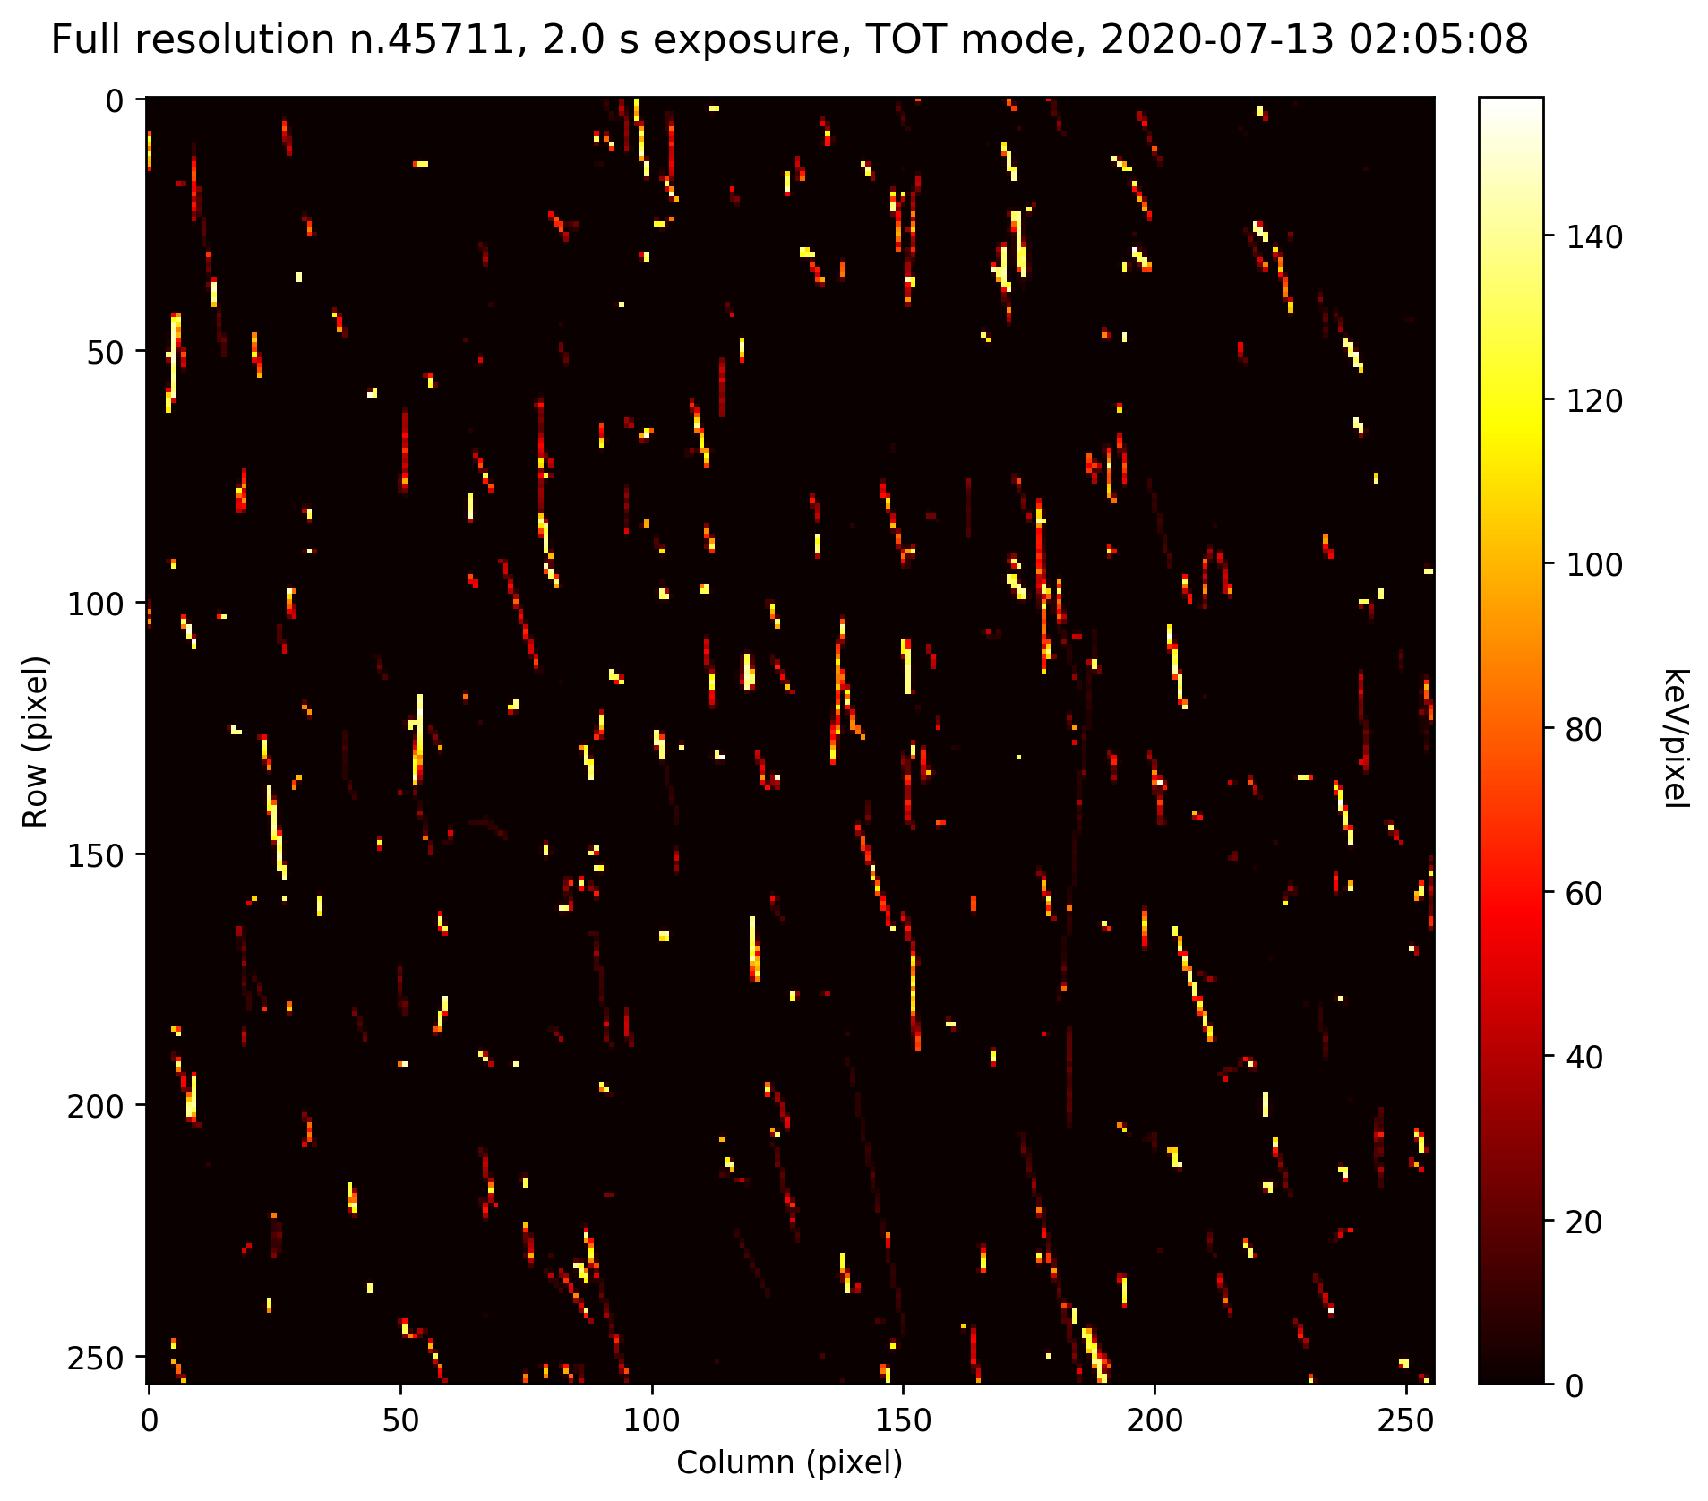
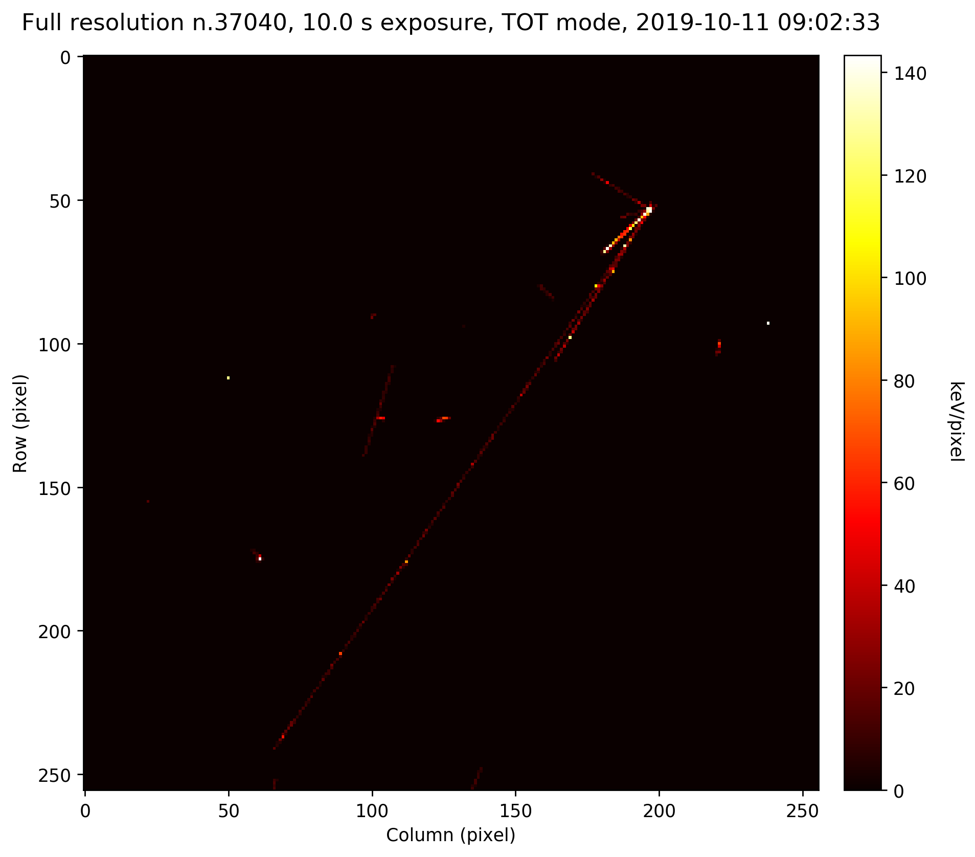
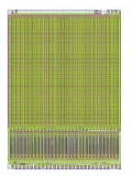
Existing solutions
More than 50 satellites
SiriusSat-1
SiriusSat-2
Khors
Yarilo
MONITOR-1
MONITOR-2
MONITOR-3
MONITOR-4
TimePix - matrix radiation detector on the ISS and VZLUSAT-1
SpacePix 2 - matrix radiation detector on the SOCRATES
Notes:
Перечислить подходящие спутники

Slide 7
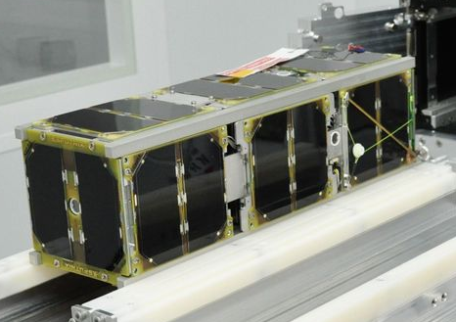
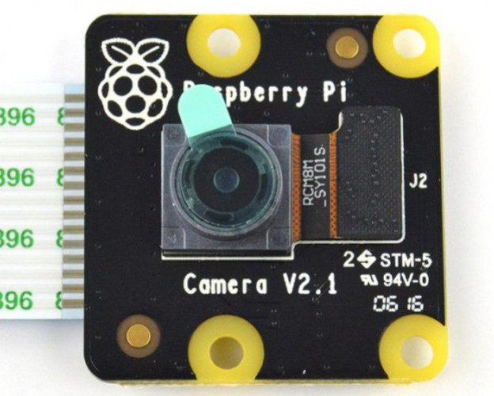
Hardware
Camera comparison:
 | Rpi V2 NoIR | Rpi V3 | Timepix | SpacePix 2
Pixel size (microns) | 1.12 | 1.4 | 55 | 60
Resolution | 2592x1944 | 4608x2592 | 256x256 | 64x64
CubeSat MONITOR-1
Camera on board - Raspberry Pi Camera v2 NoIR (without infrared filter)
NORAD ID: 53374
Size: 3U
Launch date: 09.08.22
Weight: 2.84 kgs

Slide 8

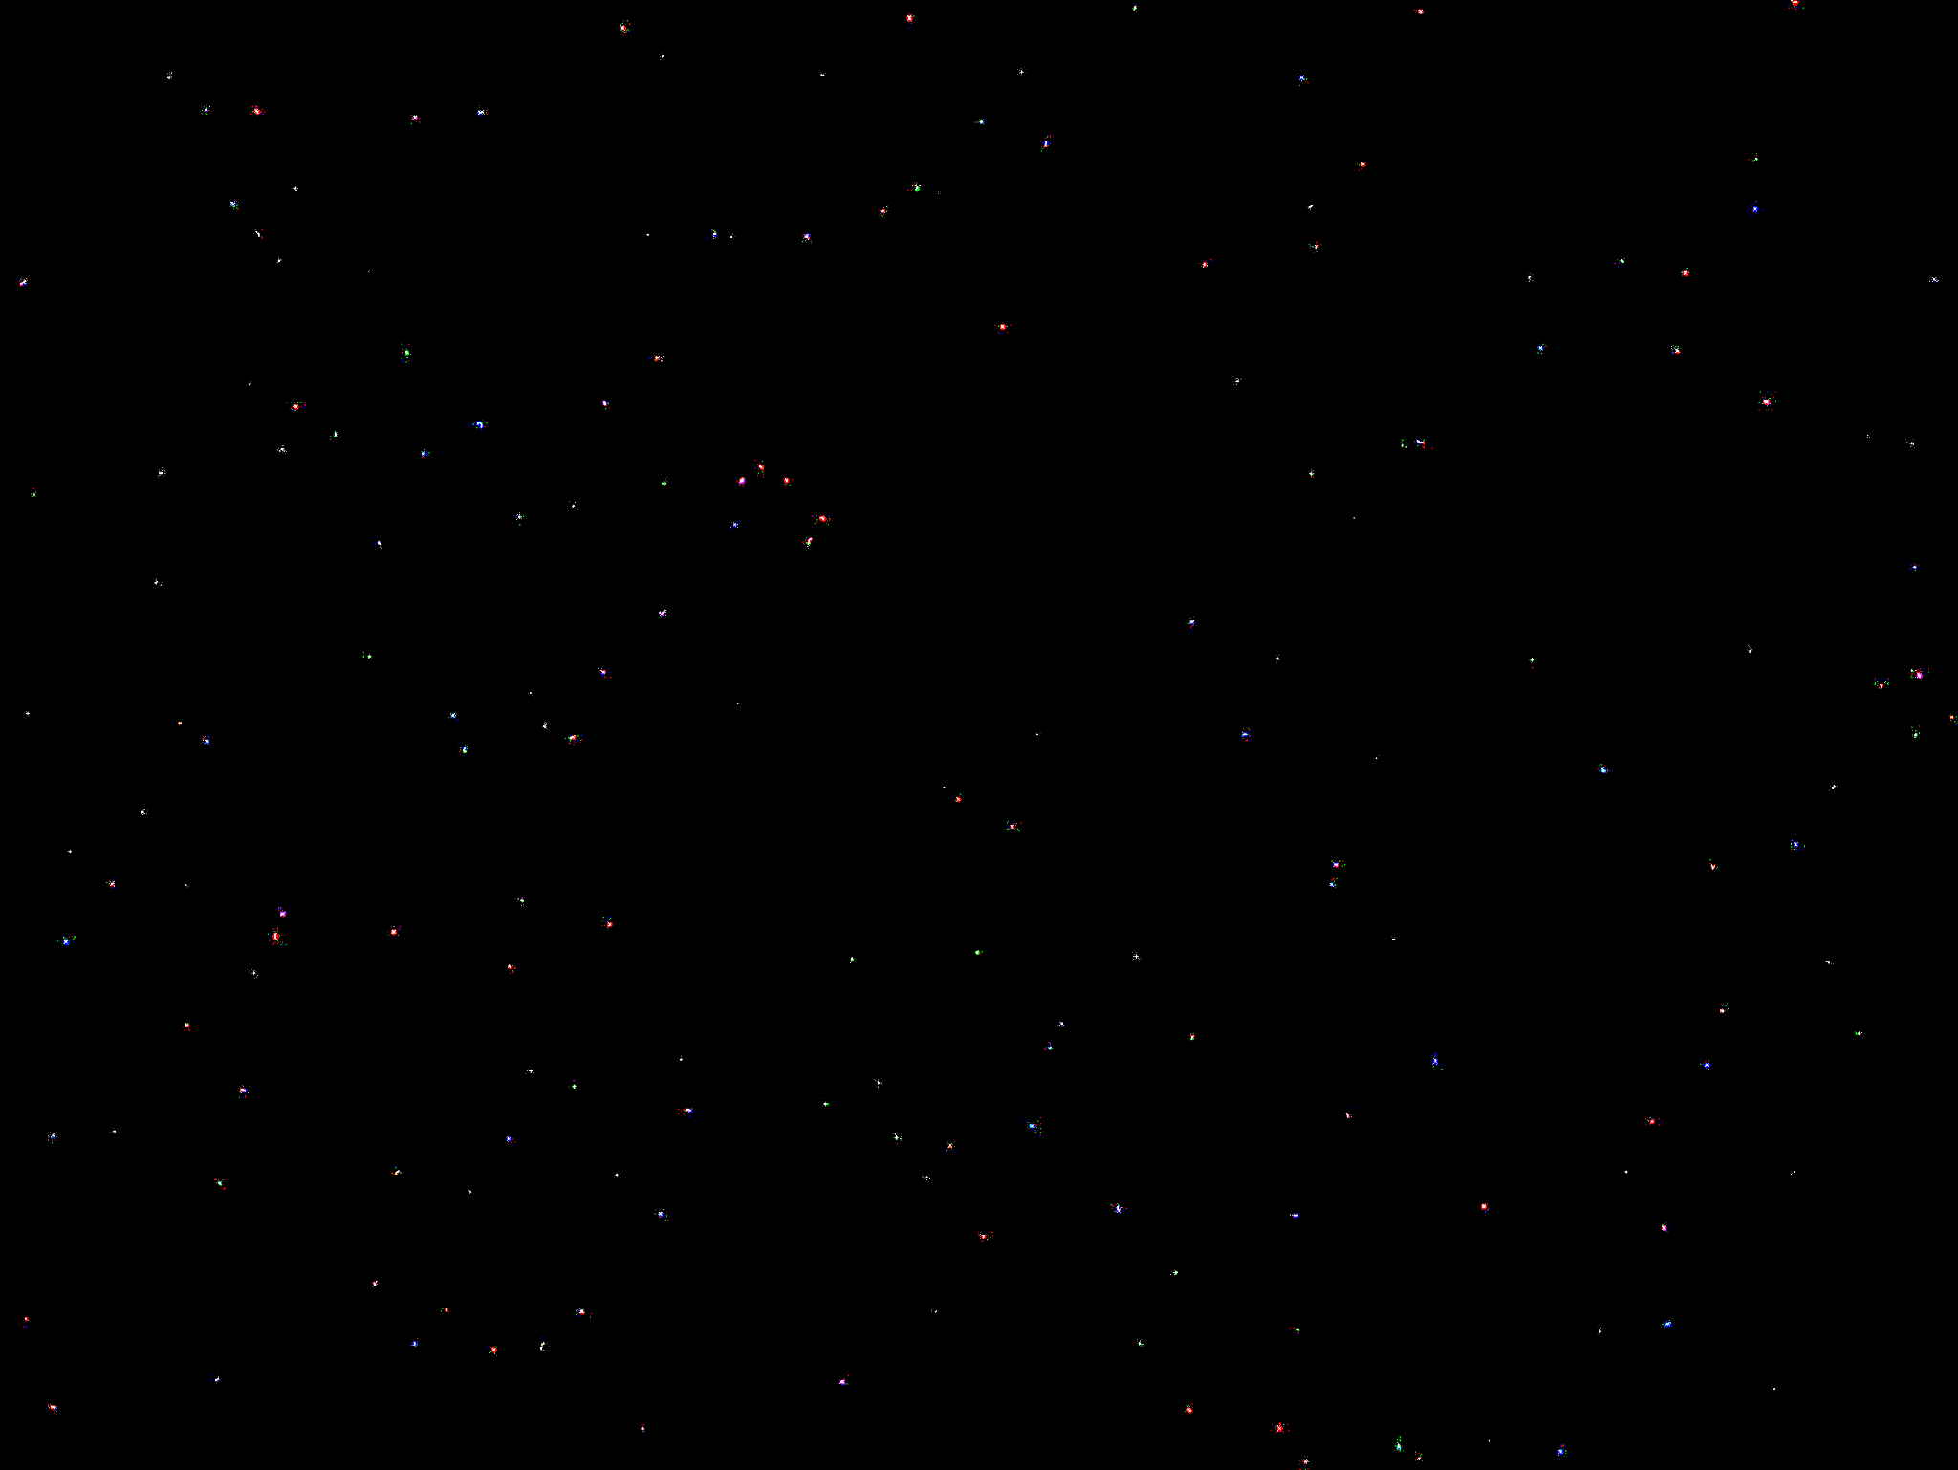
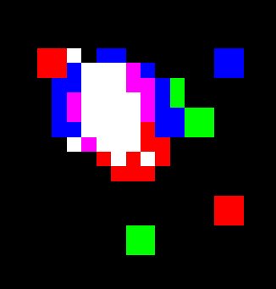
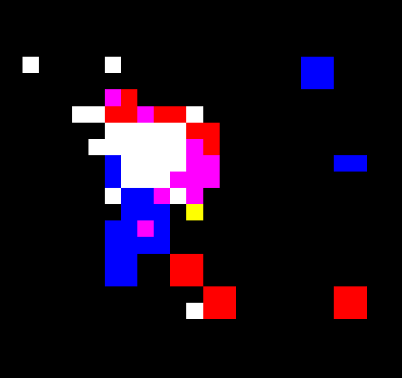
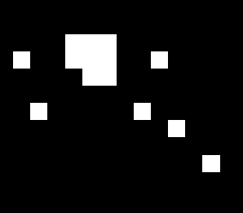
Tracks
Rpi NoIR camera, shutter speed 3s
2023/07/04 13:45 Sirius
Rapiscan 628 XR: 49 tracks, 127 particles
SOHO LASCO C3

Slide 9
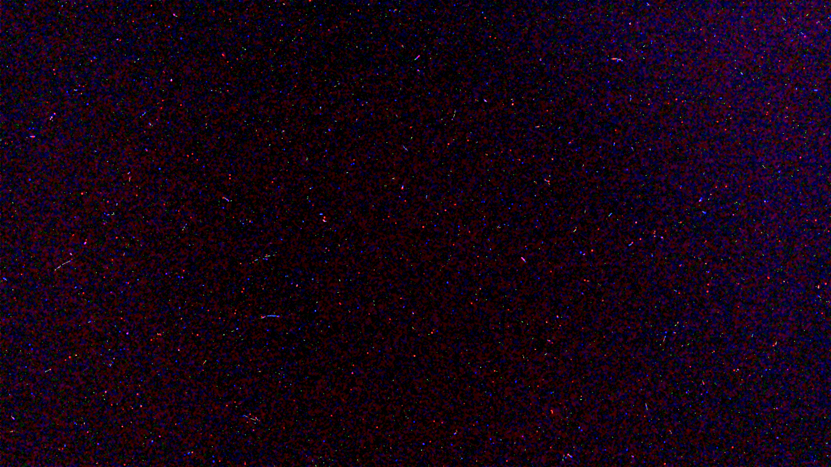
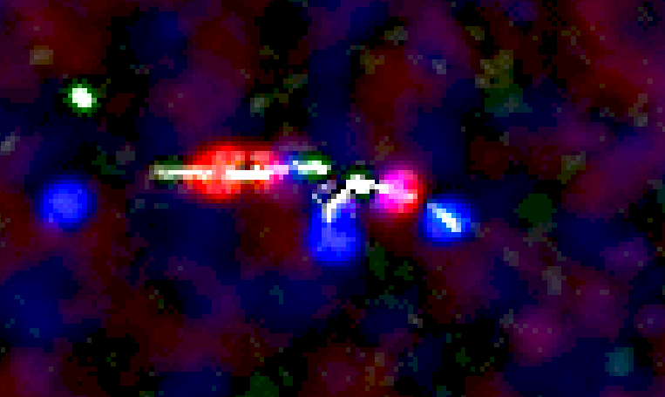
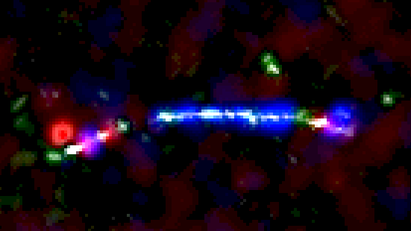
SINP
SOHO LASCO C3
Rpi camera v2 NoIR 3s, 20.07.2023, Moscow. Strontium 90: 714 tracks, 1441 particles

Slide 10
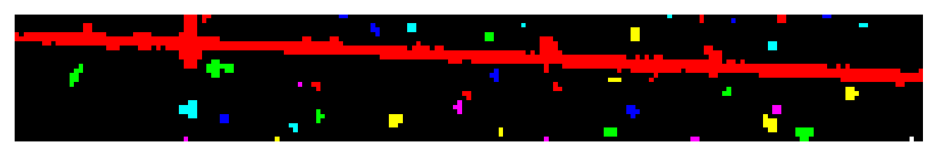

Image processing
0. Loading the image
Binarization
2. Outline detection
3. Classification of the tracks
SOHO LASCO C3

Slide 11
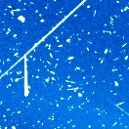
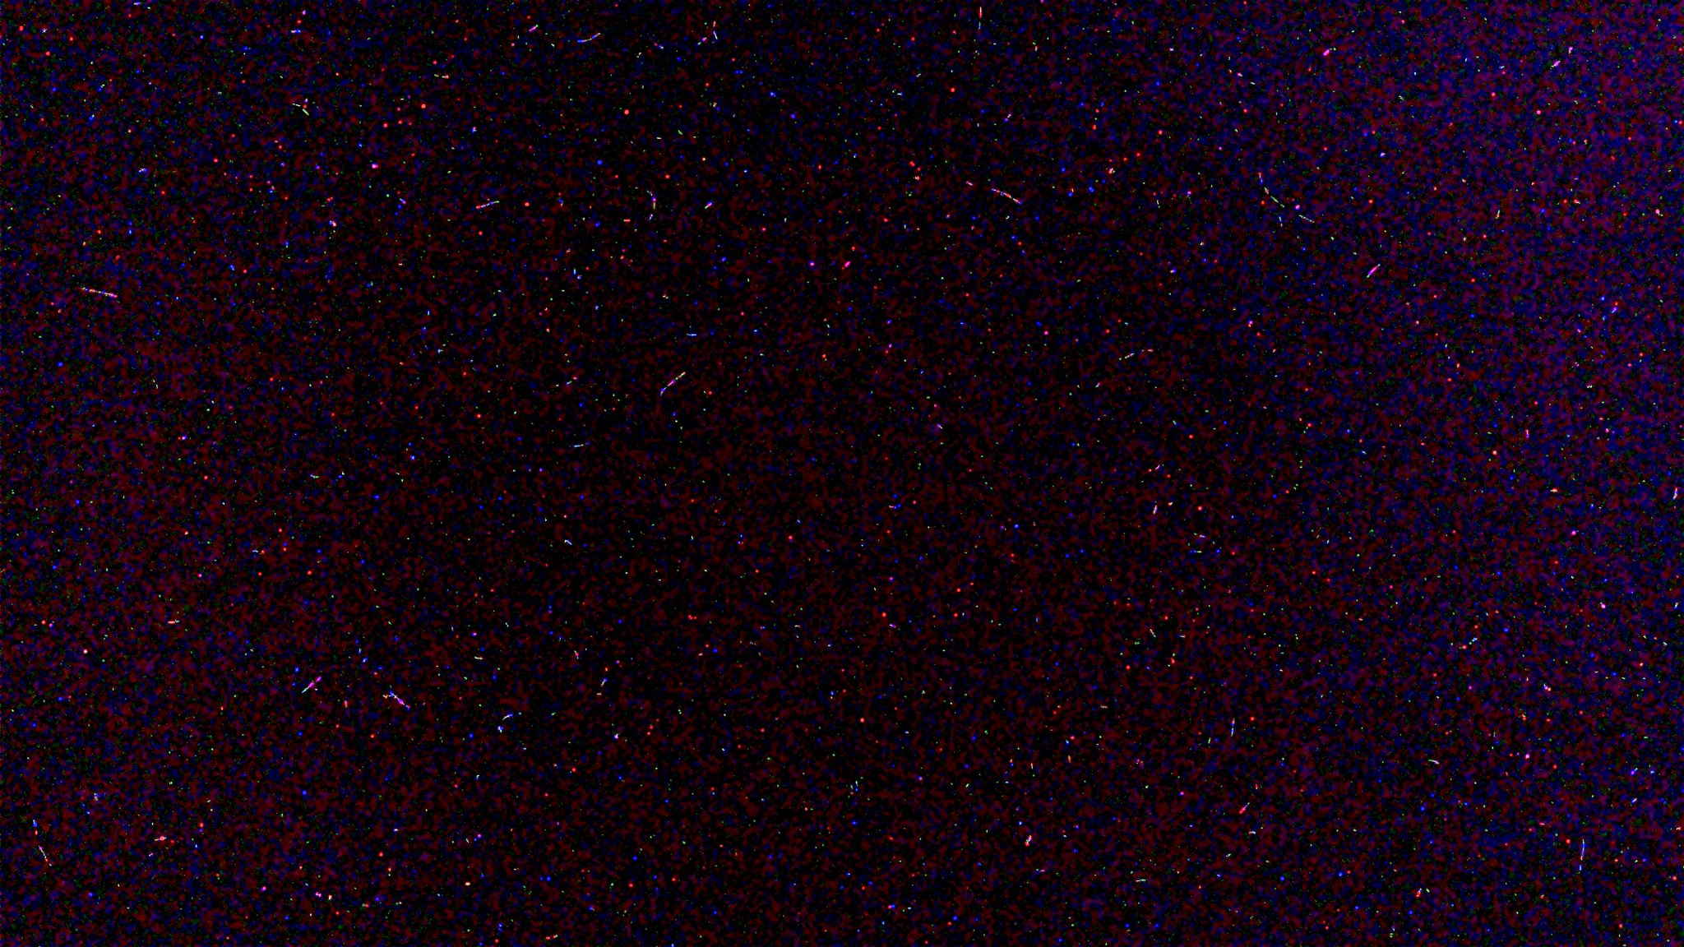
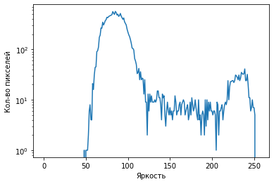
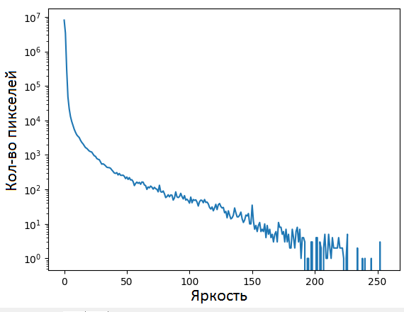
Binarization
20.07.2023 Moscow, Strontium 90
SOHO LASCO C3
704 tracks, 1298 particles
SOHO LASCO C3

Slide 12

Outline detection
1. Recursion algorithm:
1) Searching exposed pixels
2) Neighbors analysis
3) Recursion
SOHO LASCO C3
Notes:
Добавить алгоритм с соседями. 2 анимации

Slide 13
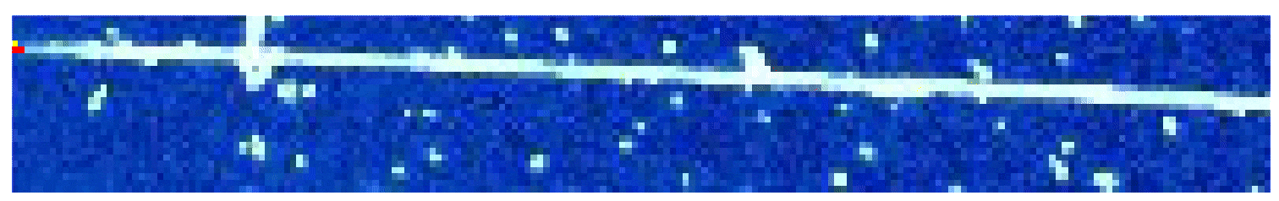
Выделение контуров
2. Improved algorithm:
1) Searching exposed pixels
2) Using additional array of the neighbors of the exposed pixels
3) Loops
SOHO LASCO C3
Notes:
Добавить алгоритм с соседями. 2 анимации

Slide 14
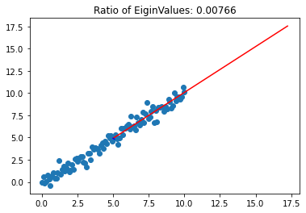
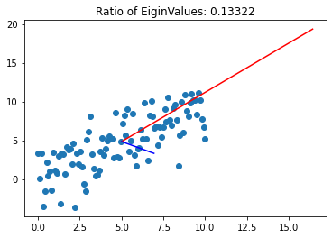
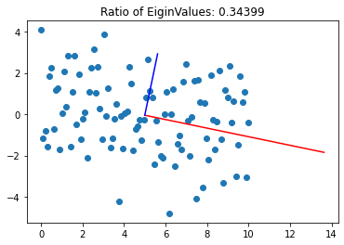
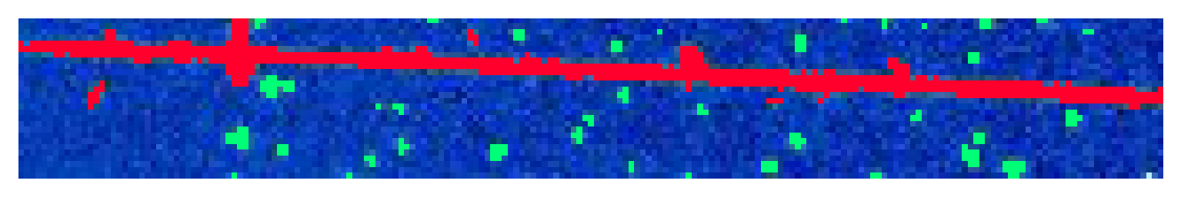
Classification
Principal Component Analysis (PCA):
SOHO LASCO C3
Notes:
Добавить алгоритм с соседями. 2 анимации

Slide 15
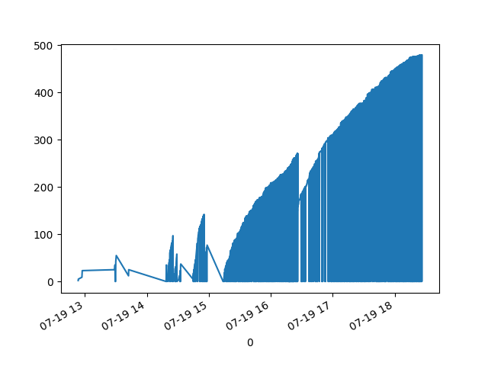
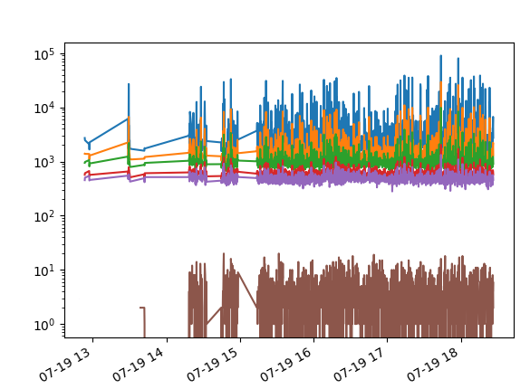
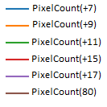
Mountains
number of groups of the pixels
number of exposed pixels
1350м
1160м
2320м
16:30
Data from Rpi 4 Rpi v2 NoIR
X axis - time mm-dd hh

Slide 16
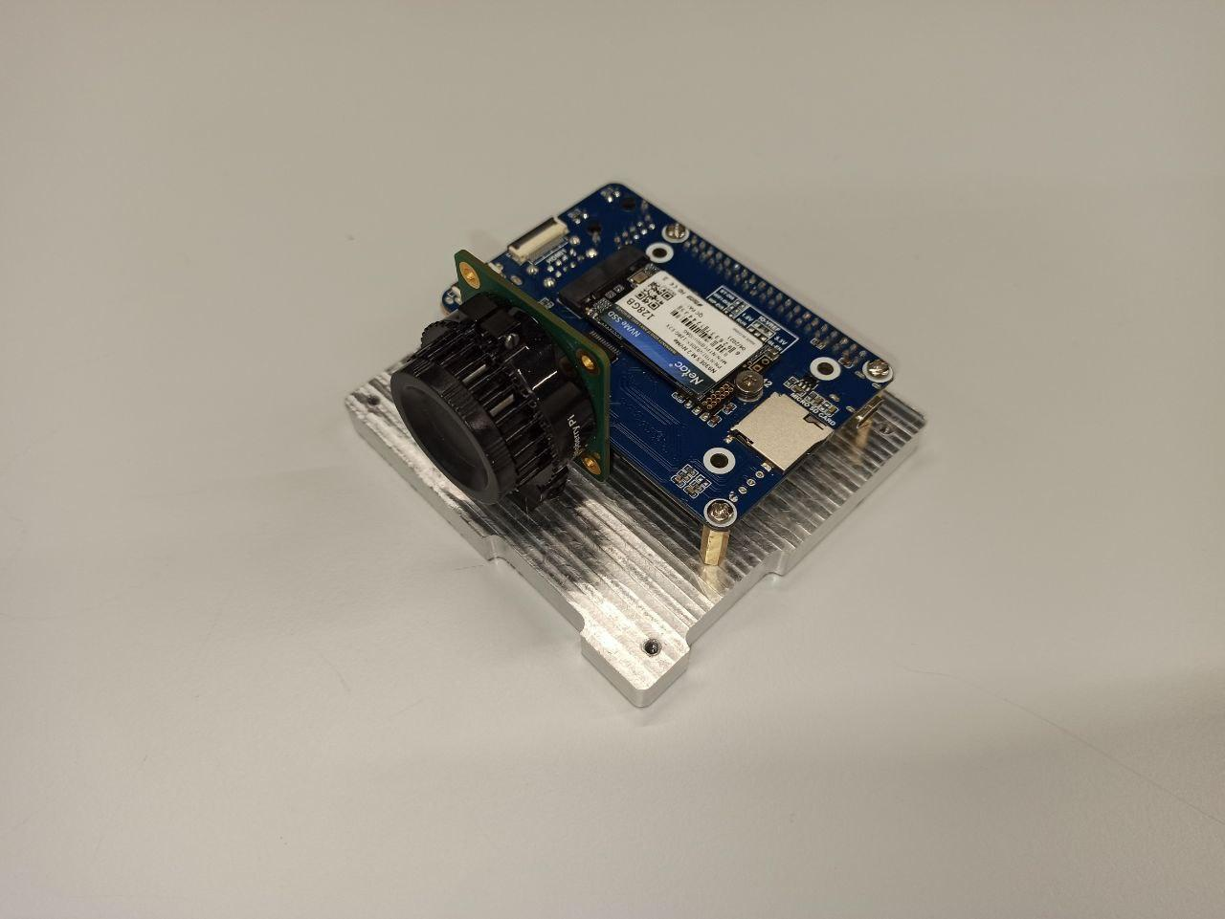
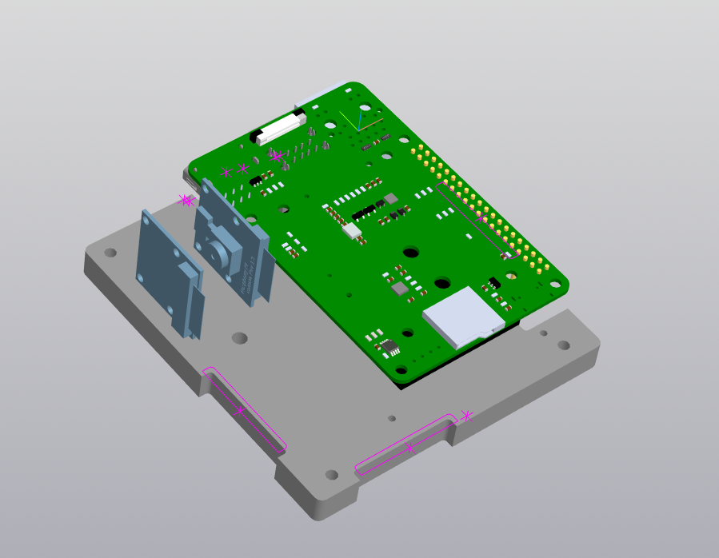
МАДИЗ
MADIZ
Matrix Detector of Radiation
- Weight 340г
- Dimensions 91x98x65 mms
- Energy consumption less than 2 Watts
- Voltage 5V
- Field of View up to 180 deg
- Sensitivity from 25 MeV
3D model
Rpi 4 compute module
2 cameras Rpi

Slide 17
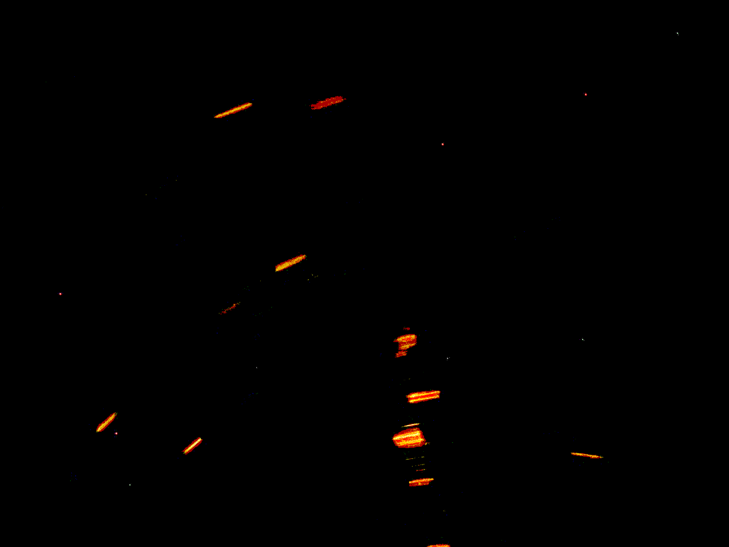
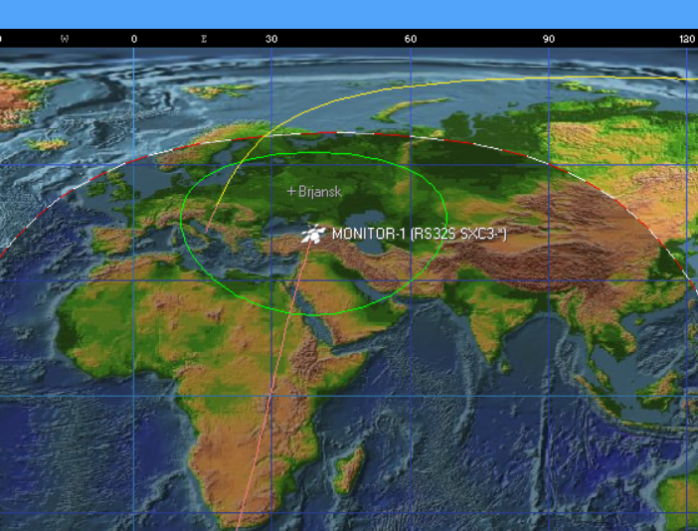
Photo from space
13.07.2023 00:10
MONITOR-1 Rpi camera v2 NoIR (enhanced): 0 tracks, 7 particles
SOHO LASCO C3
Notes:
Доделать выделение

Slide 18
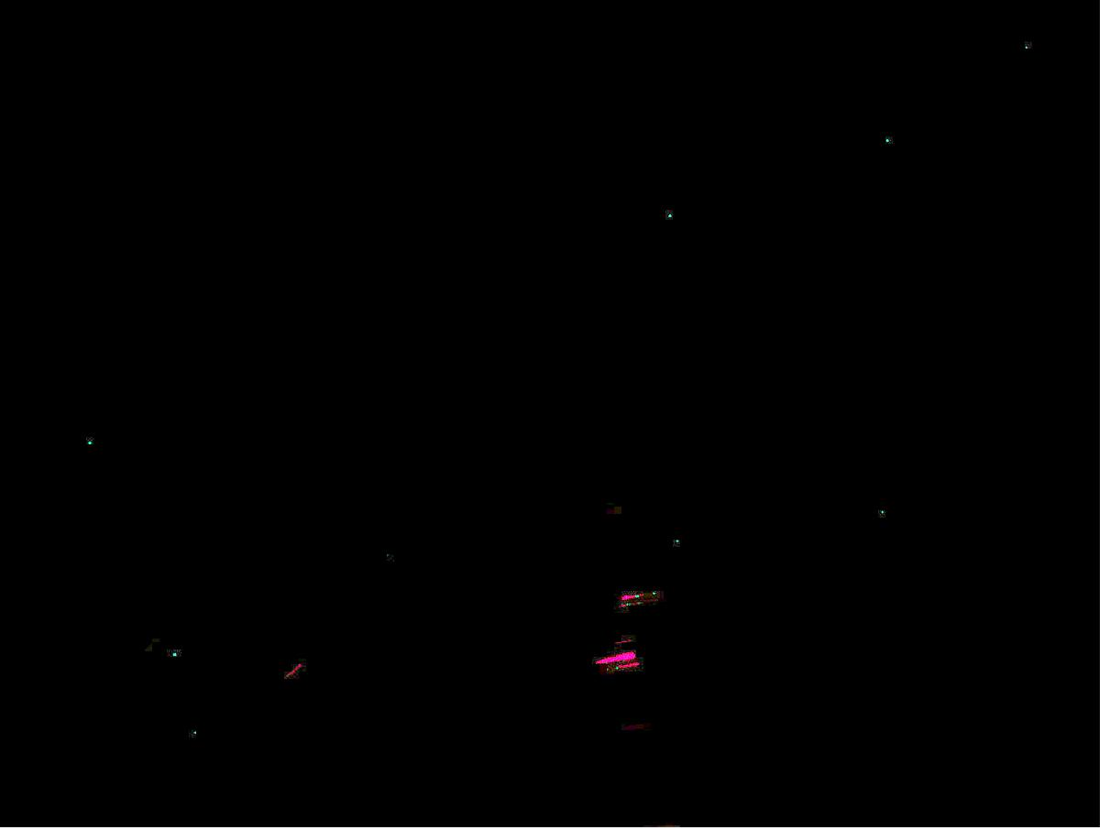
Photo from space
Enhanced
Processing result
SOHO LASCO C3

Slide 19
Image processing
Statistics
 |  | Track |  | Lines |  | Points
Names groups | Angle | mean | stddev | mean | stddev | mean | stddev
Sr 90 | 0 deg | 2198 | 55 | 819 | 17 | 1378 | 45
 | 30 deg | 1638 | 575 | 552 | 199 | 1086 | 377
 | 45 deg | 1483 | 39 | 501 | 32 | 982 | 9
Rapiscan 628 XR | 0 | 172 |  | 49 |  | 127
Earth | - | 7 |  | 0 |  | 7
SOHO LASCO C3

Slide 20
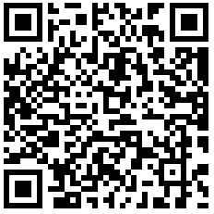
Results
- Algorithms in Python, C++ for finding tracks and particles
- Algorithms have been tested on Earth
- Photos from the satellite have been analyzed
- MADIZ prototype has been developed
github.com/lightweave/madiz
Notes:
Ссылка на сайт

Slide 21
Plans
- Development of a self-adapting particle track detection system
- Testing of algorithms on several satellites
- Development of algorithms for analyzing paired photos of the MADIZ satellite
SOHO LASCO C3

Slide 22


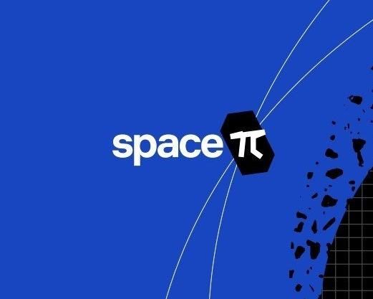
Thanks for attention!

